Slide 1

Intro to subgroup analysis
Global Drug Development Advanced Exploratory Analytics

Slide 2
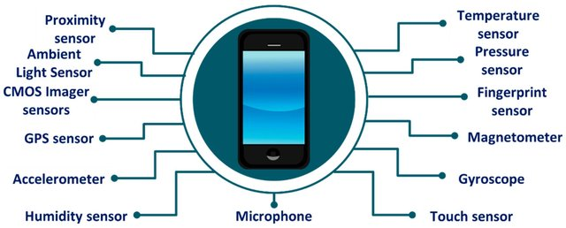
Machine learning
One response Y, e.g. disease progression/status
Thousands of variables X: e.g. genotype information, censored ...
medical outcome
lots of gene expression measurements
few patients
Notes:
Which genetic variation affect the risk of a disease? Finding which variables affect some disease is the first step of a long process, it’s hypothesis generation.
We want to understand which mutations are in the pathway of some disease, in a way that when we give a list to the biologist this is reproducible How can we select variables without too many false positives, so we do not run into problems related with the irreproducibility of our findings
, she will not waste more than 10% of the time to explore false positives.
data coming from sensors, digital data. understand disease progression
Which gene expression profiles determine the severity of a tumor?
Which factos/variable help determine whether a loan will be repaid?

Slide 3


Machine Learning Terminology
Subject | age | enzyme | protein(g) | sodium(mg) | Diabetes?
1 | 70 | 4 | 1 | 10 | 1
2 | 23 | 3 | 5 | 2 | 1
3 | 56 | 4 | 1 | 9 | 0
4 | 50 | 4 | 0 | 14 | 0
5 | 12 | 2 | 2 | 1 | 1
6 | 56 | 2 | 2 | 1.5 | 0
… | … | … | … | … | …
… | … | … | … | … | …
… | … | … | … | … | …
… | … | … | … | … | …
N | 56 | 1 | 5 | 2 | 0

Slide 4
Machine Learning Terminology
Subject | age | enzyme | protein(g) | sodium(mg) | Diabetes?
1 | 70 | 4 | 1 | 10 | 1
2 | 23 | 3 | 5 | 2 | 1
3 | 56 | 4 | 1 | 9 | 0
4 | 50 | 4 | 0 | 14 | 0
5 | 12 | 2 | 2 | 1 | 1
6 | 56 | 2 | 2 | 1.5 | 0
… | … | … | … | … | …
… | … | … | … | … | …
… | … | … | … | … | …
… | … | … | … | … | …
N | 56 | 1 | 5 | 2 | 0
“Examples”
… a.k.a.
data-points, examples,
instances, objects.
“Variables”
… but also known as…
features, attributes, predictors, or
explanatory/independent variables.
“Labels”
… but also known as…
outcomes, class,
dependent variable.

Slide 5
Machine Learning Pipeline
Class, or “label”
Target variable
“Features”
“Examples”
Training data + labels
eg health records
Model fitted to training data
Test input
Label prediction
Notes:
Standard supervised learning scenario.
Filter Methods.

Slide 6
Machine Learning Pipeline
Class, or “label”
Target variable
“Features”
“Examples”
Fits the parameters of our chosen model to the data.
Training data + labels
eg health records
Statistical/ML Algorithm
Model fitted to training data
Test input
Label prediction
Linear/Logistic Regression
(Deep) Neural Network Decision Trees
Ensemble methods
(e.g. bagging, boosting, forests)
Notes:
Standard supervised learning scenario.
Filter Methods.

Slide 7

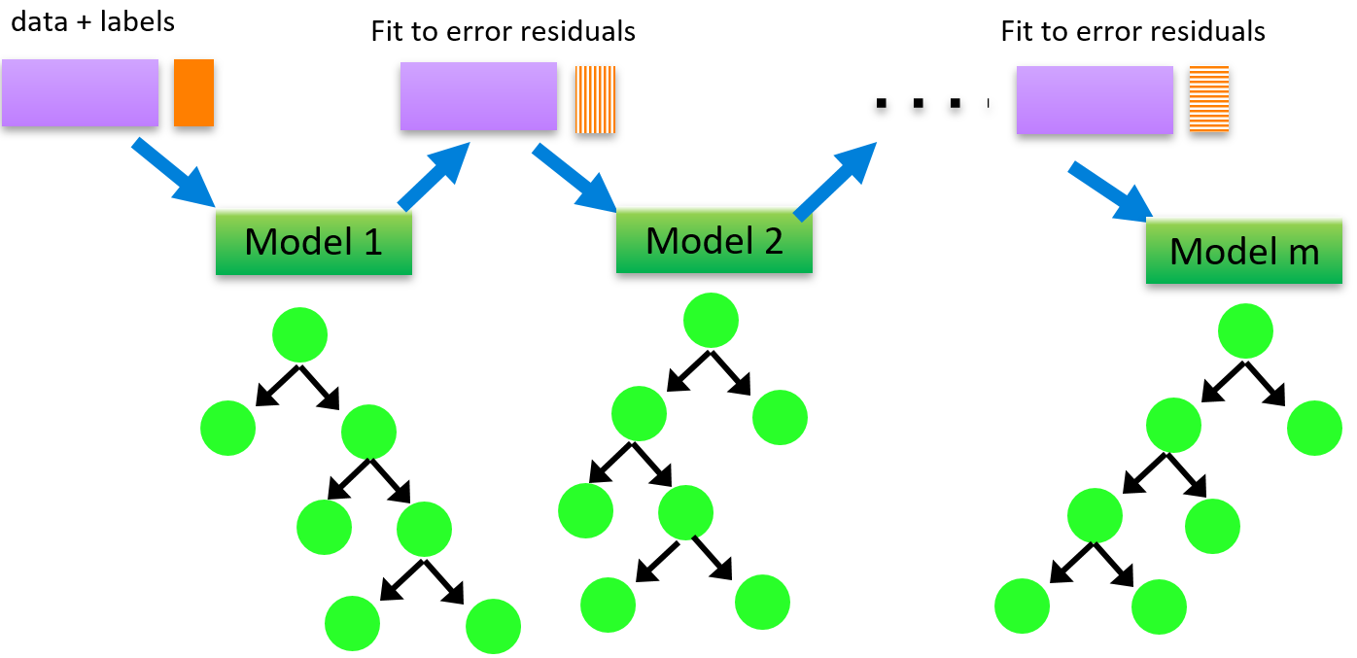

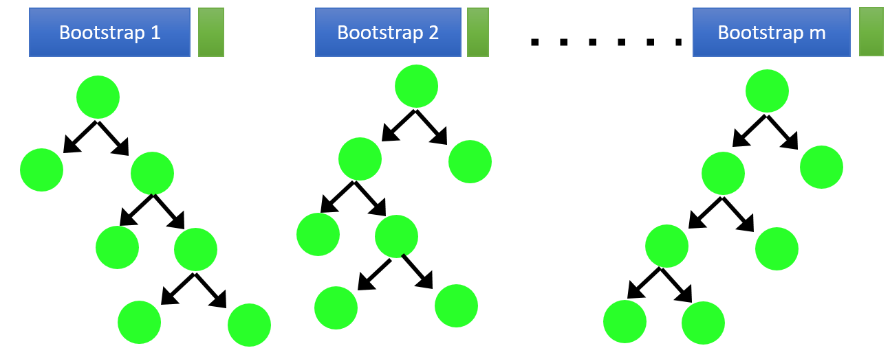
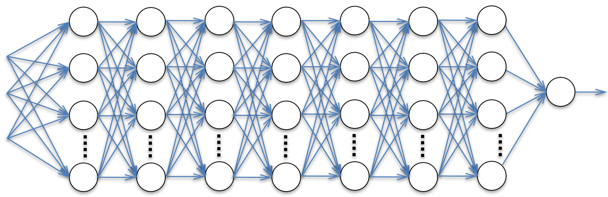

Feature selection
LASSO
Features
Target variable
$$Y$$
$$X_{1 }{ X}_{2 }{ X}_{3 }X_{4 }X_{5 } X_{6} X_{7 }…{ X}_{p}$$
Gradient boosted trees
Random forest
Fits the parameters of our chosen model to the data.
ML model
(Deep) neural networks

Slide 8





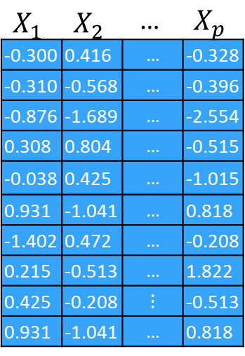

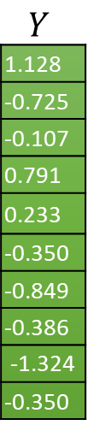
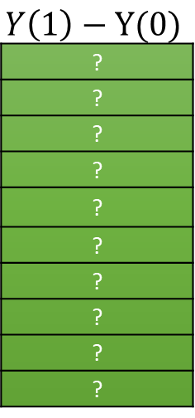
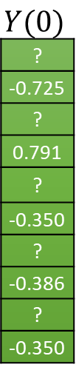
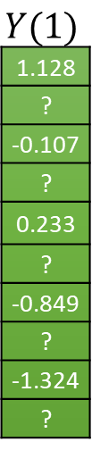

Clinical trial data
$$X_{1}$$ | $$X_{2}$$ | $$\text{…}$$ | $$X_{p}$$
-0.300 | 0.416 | $$\text{…}$$ | -0.328
-0.310 | -0.568 | $$\text{…}$$ | -0.396
-0.876 | -1.689 | $$\text{…}$$ | -2.554
0.308 | 0.804 | $$\text{…}$$ | -0.515
-0.038 | 0.425 | $$\text{…}$$ | -1.015
0.931 | -1.041 | $$\text{…}$$ | 0.818
-1.402 | 0.472 | $$\text{…}$$ | -0.208
0.215 | -0.513 | $$\text{…}$$ | 1.822
0.425 | -0.208 | ⋮ | -0.513
0.931 | -1.041 | $$\text{…}$$ | 0.818
$$T$$
1
0
1
0
1
0
1
0
1
0
$$Y$$
1.128
-0.725
-0.107
0.791
0.233
-0.350
-0.849
-0.386
-1.324
-0.350
$$Y(1)$$
1.128
?
-0.107
?
0.233
?
-0.849
?
-1.324
?
$$Y(0)$$
?
-0.725
?
0.791
?
-0.350
?
-0.386
?
-0.350
$$Y\left(1\right)−Y(0)$$
?
?
?
?
?
?
?
?
?
?
$T$ = 1
$T$ = 1
$T$ = 0
$T$ = 0

Slide 9
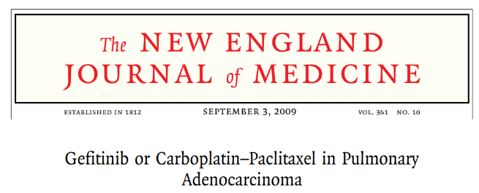
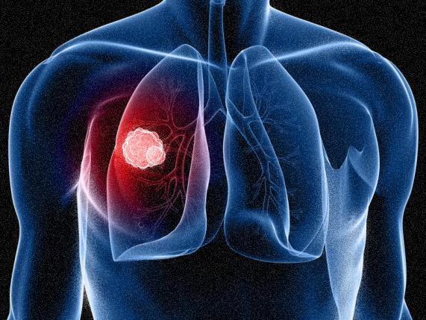
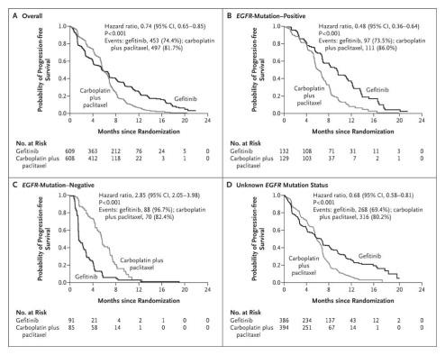
From FS to predictive biomarker discovery
A framework for discovering predictive biomarkers, such as EGFR, by controlling FDR
EGFR positive
EGFR negative
EGFR
EGFR mutation is predictive ...
Gefitinib
Carboplatin-paclitaxel
EGFR: Epidermal Growth Factor Receptor

Slide 10


Virtual Twins
Subgroup Identification from Randomized Clinical Trial Data
Foster et al, 2011, Statistics in Medicine - Eli Lilly
First observation:
It’s a catchy name for counterfactual modeling (Rubin 1974).
Prof Donald G. Rubin
Harvard Statistics Dept.
How it works (1)
For a two arm trial, with a selected outcome (could be efficacy or safety)
1. Derive predictive model for control arm patients
2. Derive predictive model for active arm patients
3. Apply active model to control data
4. Apply control model to active data
Models built using RF (Random Forests)
Control
Active
So each patient has two predicted probabilities of response: one for treatment they received, and one for the treatment they didn’t receive

Slide 11

Virtual Twins
How it works (2)
A Virtual Twin is an identical copy of a real patient, except that they received the opposite treatment
p=0.5
p=0.3

Slide 12
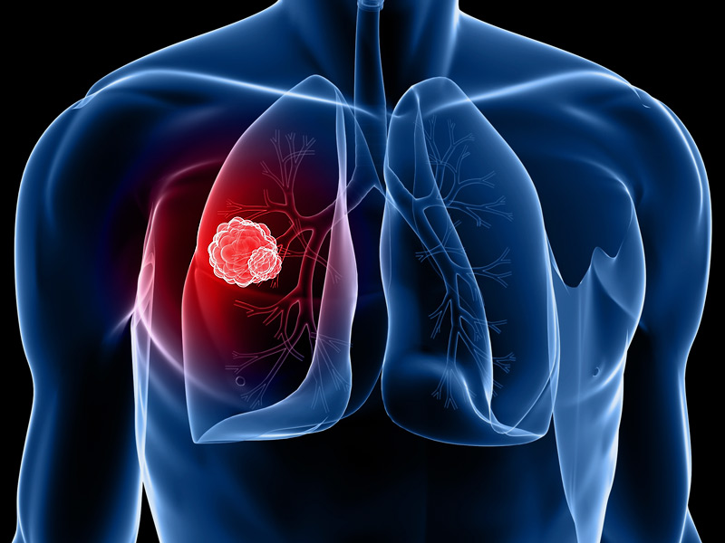
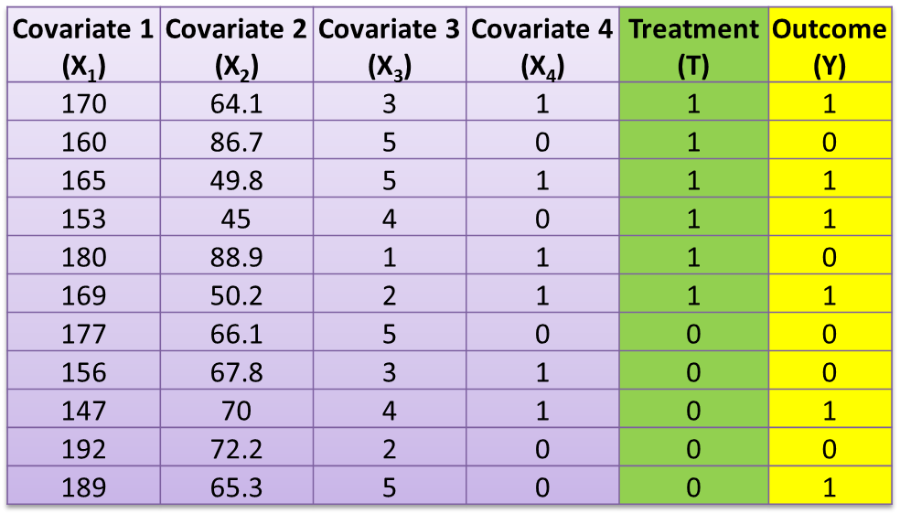
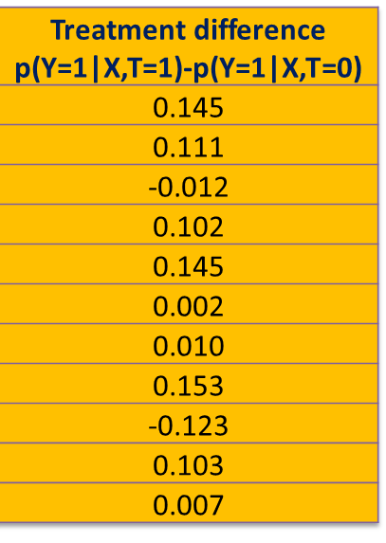
Potential Outcome Modeling
“Virtual Twins” (Foster et al. 2011)
1. Derive predictive model for control arm p(Y=1|X,T=0)
2. Derive predictive model for treatment p(Y=1|X,T=1)
4. Apply control model to active data
3. Apply active model to control data
Control
Treatment

Slide 13
Predictive biomarker discovery
Prognostic markers: X₁,X₂
Predictive markers: X₃,X₂
$$E\left[Y | X,T\right]=a_{1}X_{1}+a_{2}X_{2}+(a_{3}{ X_{2}+a_{4}X}_{3})T$$
$$E\left[Y | X,T\right]= h\left(X\right) + g\left(X\right)T$$
Two main families of literature for predictive biomarker discovery… 1. Penalized linear regression methods
Modified Covariate Regression (Tian et al. 2014) Journal of the American Statistical Association
Regularized Outcome Weighted (Xu et al. 2015) Biometrics
2. Recursive partitioning methods
Interaction Trees (Su et al. 2009) Journal of Machine Learning Research (JMLR)
SIDES/Screen (Lipkovich & Dmitrienko 2014) Journal of biopharmaceutical statistics
Virtual Twins (Foster et al. 2011) Statistics in Medicine
Causal Forests (Athey & Imbens 2016) PNAS

Slide 14
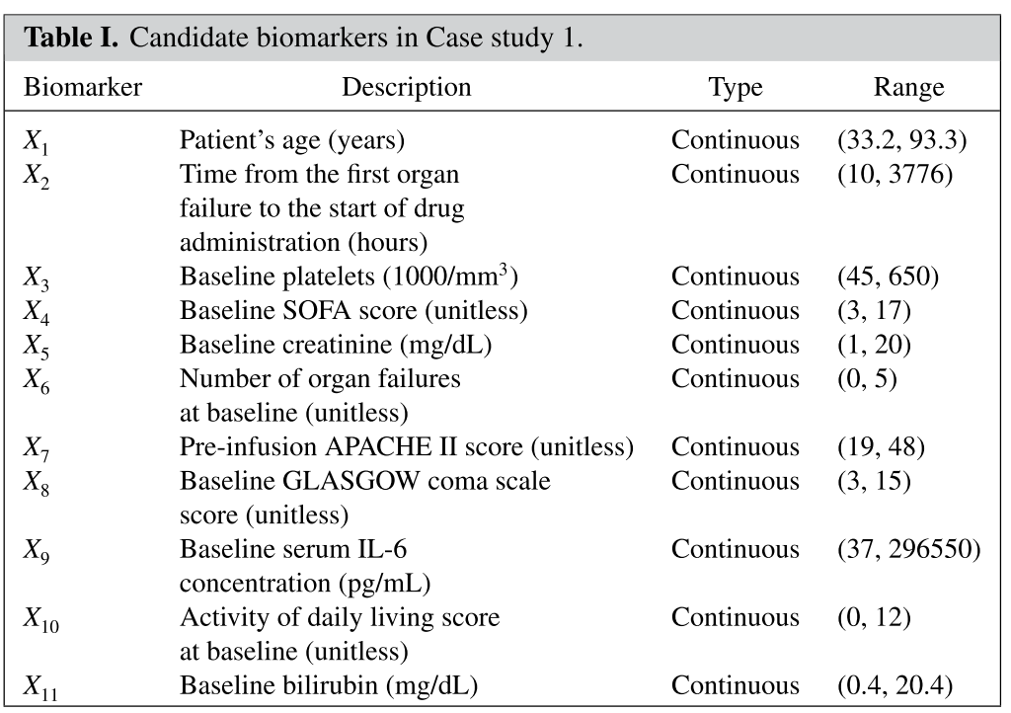
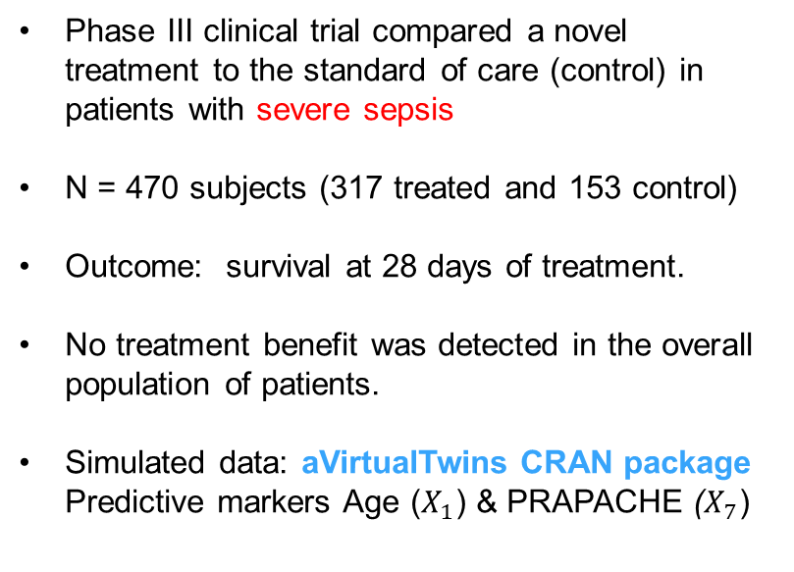
Data example: Sepsis trial (Lipkovich et al. SiM 2017)
Phase III clinical trial compared a novel treatment to the standard of care (control) in patients with severe sepsis
N = 470 subjects (317 treated and 153 control)
Outcome: survival at 28 days of treatment.
No treatment benefit was detected in the overall population of patients.
Simulated data: aVirtualTwins CRAN package
Predictive markers Age ($X_{1}$) & PRAPACHE ($X_{7}$)
Notes:
The clinical trial database can be utilized to perform a subgroup search with the objective of identifying important predictive biomarkers.
A Phase III trial was conducted to compare a novel treatment to a control (standard of care) in patients with a life-threatening disease (severe sepsis). The clinical database contains 470 patients who were randomized to the treatment arm (n = 317) or control arm (n = 153). The outcome variable for the primary analysis was a binary indicator for all-cause survival at 28 days. The trial’s overall outcome was negative. Specifically,
The list includes a demographic marker (patient age) and 10 clinical or laboratory markers.
The markers were chosen based on their prognostic value in patients with severe sepsis. For example, patients with a lower value of the APACHE II (Acute Physiology and Chronic Health Evaluation) score have a higher predicted probability of survival (Knaus et al., 1985). However, it is unclear which of these markers have predictive ability, that is, can predict a beneficial effect in patients who have receive the novel treatment.

Slide 15

Thank you!
Global Drug Development Advanced Exploratory Analytics

Slide 16
References – Detecting heterogeneity literature
(Tian et al. 2014) Tian, L., Alizadeh, A. A., Gentles, A. J., & Tibshirani, R. A simple method for estimating interactions between a treatment and a large number of covariates. Journal of the American Statistical Association.
(Xu et al. 2015) Xu, Y., Yu, M., Zhao, Y. Q., Li, Q., Wang, S., & Shao, J. Regularized outcome weighted subgroup identification for differential treatment effects. Biometrics
(Su et al. 2009) Su, X., Tsai, C. L., Wang, H., Nickerson, D. M., & Li, B. Subgroup analysis via recursive partitioning. Journal of Machine Learning Research.
(Lipkovich & Dmitrienko 2014) Lipkovich, I., & Dmitrienko, A. Strategies for identifying predictive biomarkers and subgroups with enhanced treatment effect in clinical trials using SIDES. Journal of biopharmaceutical statistics.
(Foster et al. 2011) Foster, J. C., Taylor, J. M., & Ruberg, S. J. Subgroup identification from randomized clinical trial data. Statistics in medicine.
(Athey & Imbens 2016) Athey, S., & Imbens, G. Recursive partitioning for heterogeneous causal effects. Proceedings of the National Academy of Sciences.
(Lipkovich et al. 2017) Lipkovich, I., Dmitrienko, A., & B D'Agostino Sr, R. Tutorial in biostatistics: data‐driven subgroup identification and analysis in clinical trials. Statistics in medicine.

